Slide 1


TEAM COLAB
PRESENTATION
PROJECT TITLE:
CRIME AGAINST WOMEN IN INDIA
(A Year-wise and State-wise Analysis)
August 27, 2022

Slide 2



MEET THE TEAM
IDONGESIT INYANG
NNAMDI WALTER
BARIYAT LIKITA
Group Lead
Assistant Group Lead
Query Analyst
HAMOYE ID: 1462cda03941f000
HAMOYE ID: 14fbc3609281f000
HAMOYE ID: 13c703088881f000

Slide 3
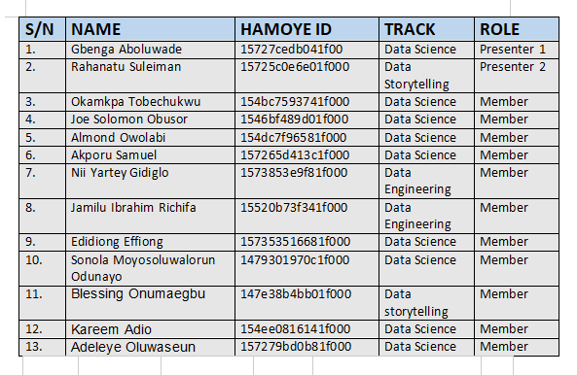
MEET THE TEAM
OTHER GROUP MEMBERS

Slide 4
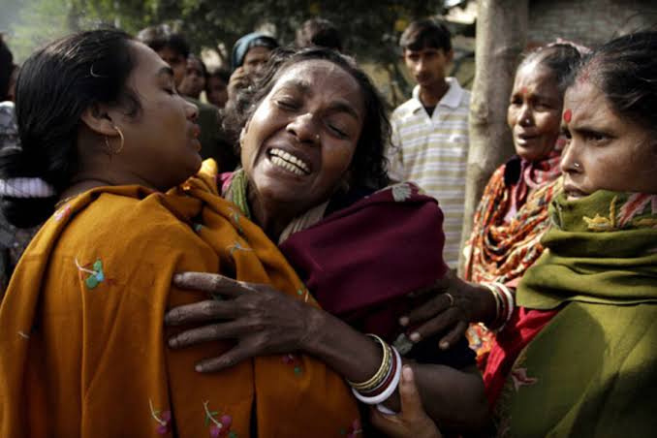
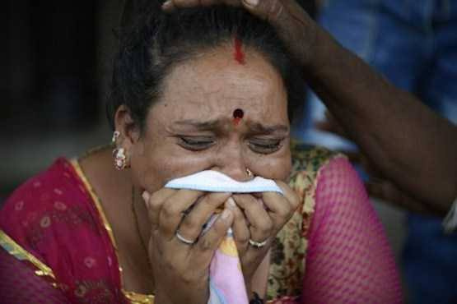
PROBLEM STATEMENT
The number of violent crimes in India especially those against women including rape that are reported in official statistics are increasing with each passing year. This violence thrives within a milieu of steady economic growth, and increasing inequality between the rich and poor in Indian society.
Ranging from the so-called eve teasing and outright sexual harassment on the street or workplace, to harassment for dowry, molestation in public transport vehicles, and the often-reported rape, these crimes against women reflect the vulnerability and deep-rooted problems related to the position of women in Indian society.

Slide 5
EXISTING WORKS
Several works have been done relating to various issues on crime in India, taking specific crime as well as crime as a whole and crime deterrence and the need for reforms.
Braithwaite (1975), Dreze and Khera (2000), Mukherjee, Rustagi and Krishnaji (2001), Shaban (2008), Dutta and Husain (2009), Bhatt and Pant (2011) and Nagarajan are examples of people that have published several works relating to crimes perpetrated against women in India.
In a seminal work, Brownmiller (1975) shows how men as men, despite racial and class differences, sustain a common interest in dominating women as women over time and across cultures. Brownmiller argues that rape is “a conscious process of intimidation by which all men keep all women in a state of fear.

Slide 6
EXISTING WORKS
All these studies mainly focused on the whole India as a country. But state level study is practically lacking in most of these works.
This project is different from earlier studies in the sense that it covers 36 major states and tried to understand the relative prevalence of crimes against women in these states and also the factors that contribute to the large inter-state variance of crimes.

Slide 7
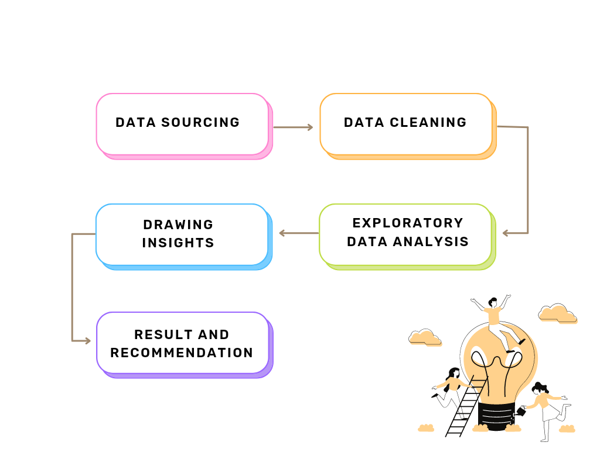
OUR APPROACH

Slide 8
DATASET DESCRIPTION
The dataset used for this project was gotten from kaggle
The dataset consists of 11 Columns and 10,677 rows.
The dataset contained no null value or duplicated row
The STATE/UT and District columns have a categorical data type while the other columns have an int64 data type

Slide 9
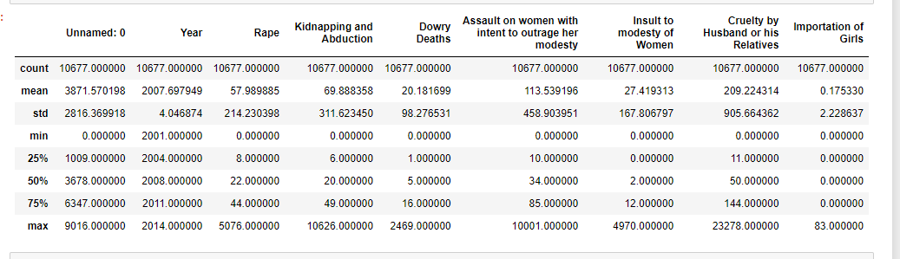
DATASET DESCRIPTION
A statistical description of the numerical columns in the dataset is shown in the image below.

Slide 10
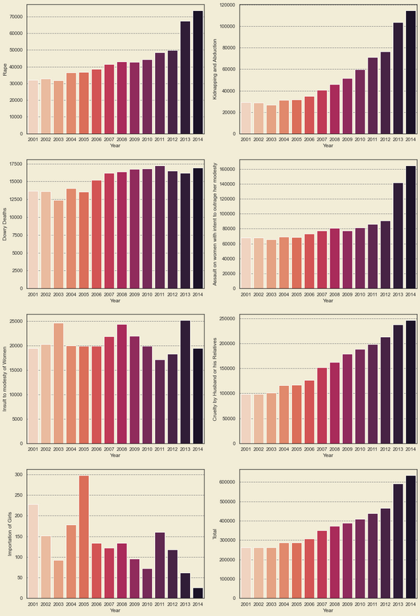
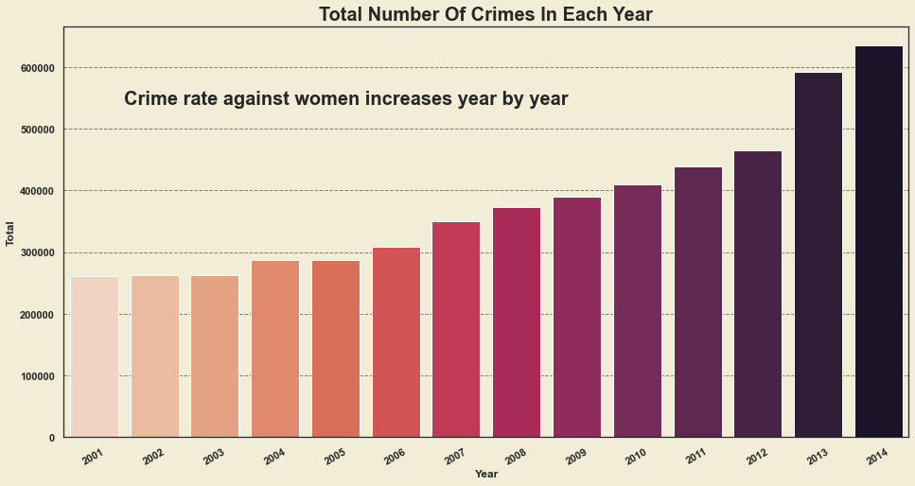
EXPLORATORY DATA ANALYSIS
YEAR-WISE ANALYSIS
TOTAL NUMBER OF CRIMES PER YEAR
ANNUAL VARIATION IN CRIME PER CATEGORY

Slide 11
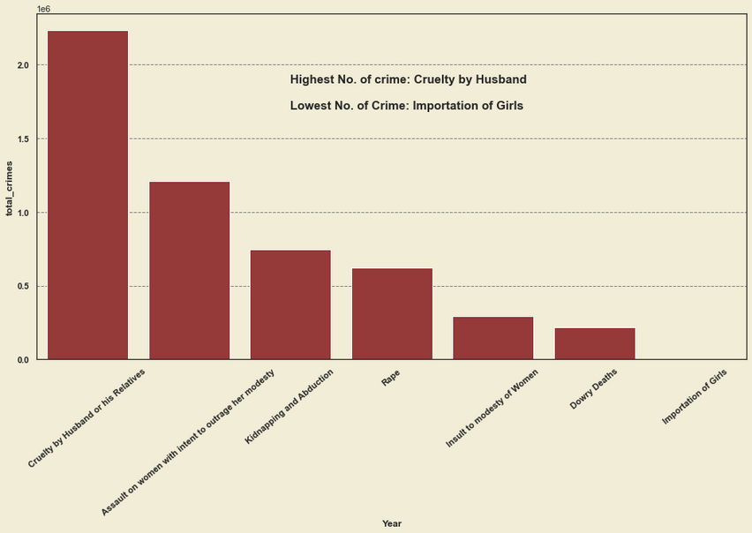
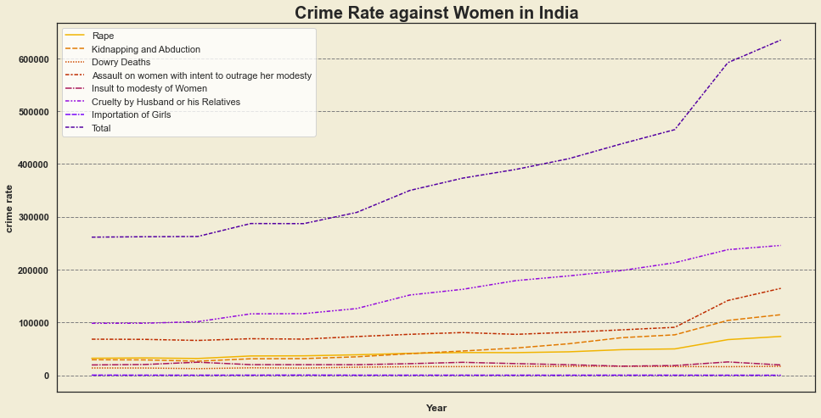
EXPLORATORY DATA ANALYSIS
YEAR-WISE ANALYSIS
TOTAL NUMBER OF CRIMES PER CATEGORY FROM 2001-2014
LINE PLOT SHOWING ANNUAL RATE OF CRIME INCREASE

Slide 12
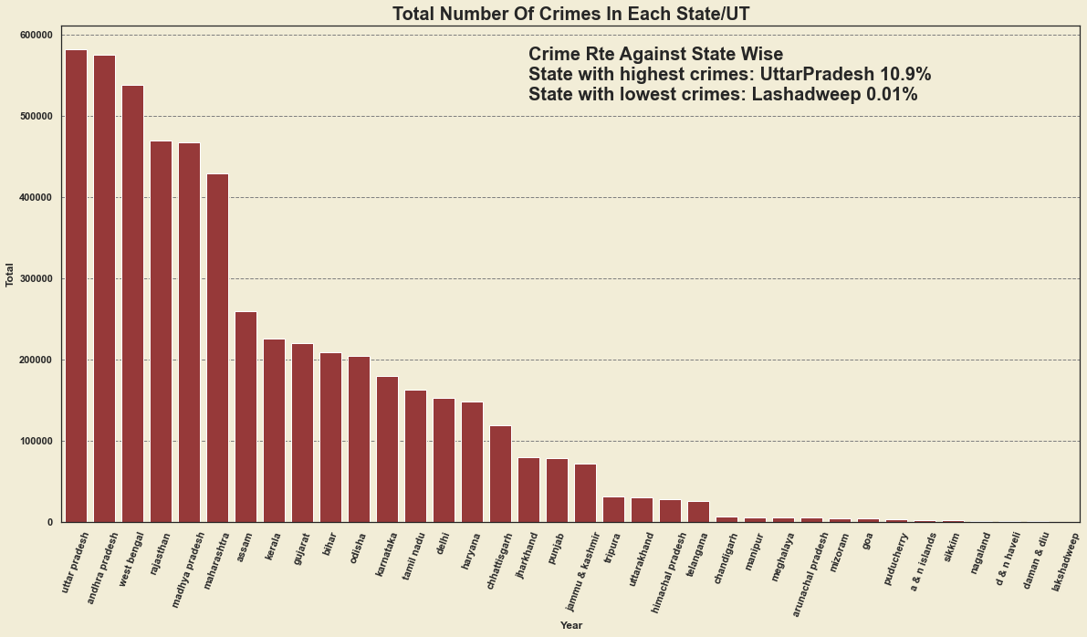
EXPLORATORY DATA ANALYSIS
STATE-WISE ANALYSIS
TOTAL NUMBER OF CRIMES PER STATE FROM 2001-2014

Slide 13
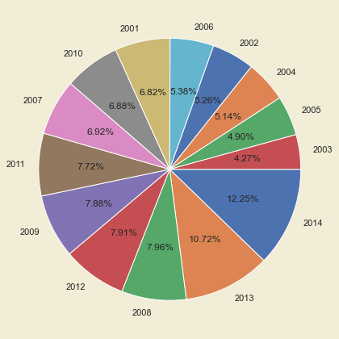
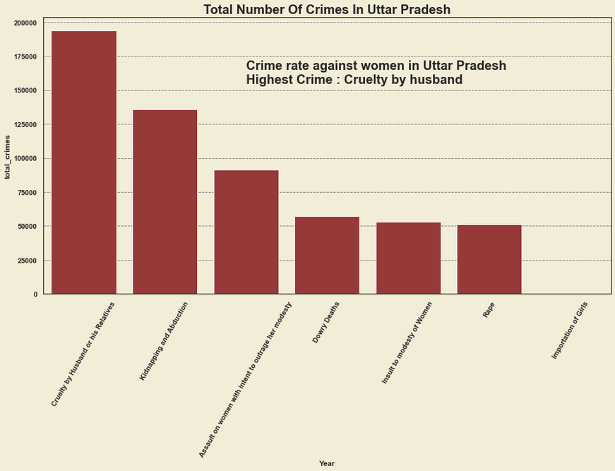
EXPLORATORY DATA ANALYSIS
ANALYSIS OF UTTAR PRADESH
TOTAL NUMBER OF CRIMES PER CATEGORY IN UTTÀR PRADESH FROM 2001-2014
PIE CHART SHOWING DISTRIBUTION OF TOTAL NUMBER OF CRIMES IN UTTAR PRADESH PER YEAR

Slide 14
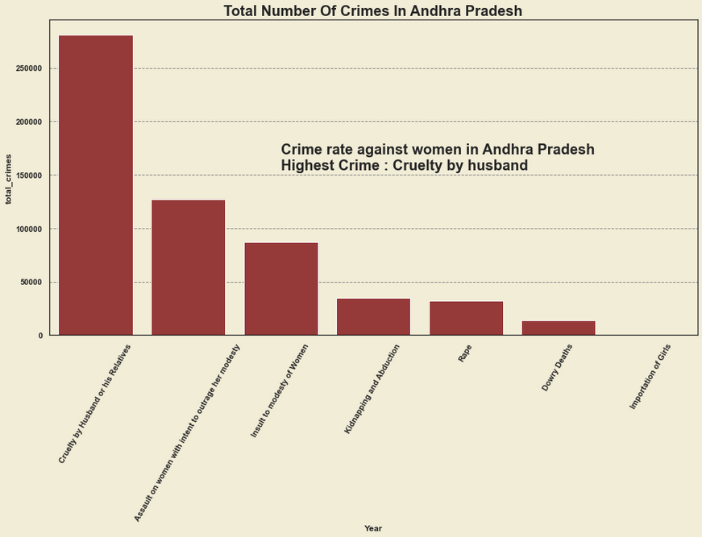
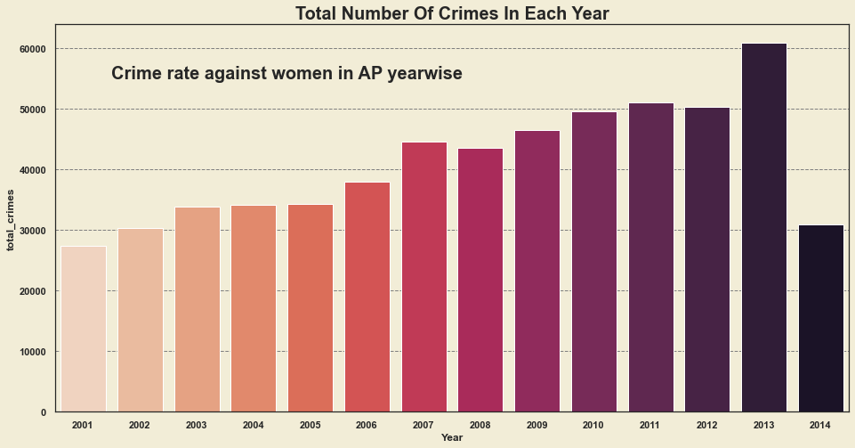
EXPLORATORY DATA ANALYSIS
ANALYSIS OF ANDHRA PRADESH
TOTAL NUMBER OF CRIMES PER CATEGORY IN ANDHRA PRADESH FROM 2001-2014
BAR PLOT SHOWING THE TOTAL NUMBER OF CRIMES IN ANDHRA PRADESH PER YEAR

Slide 15
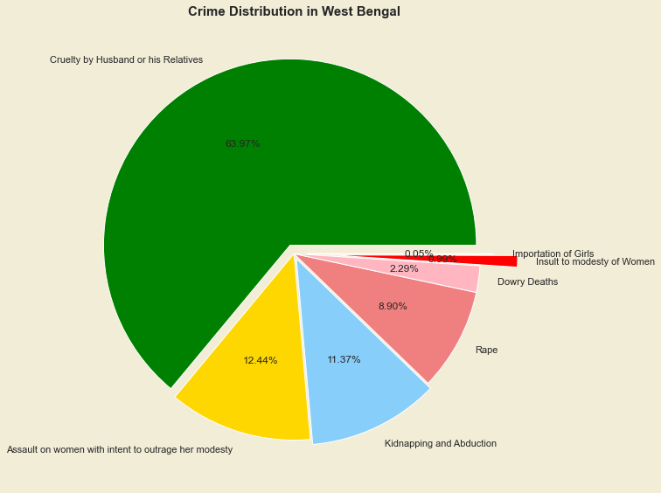
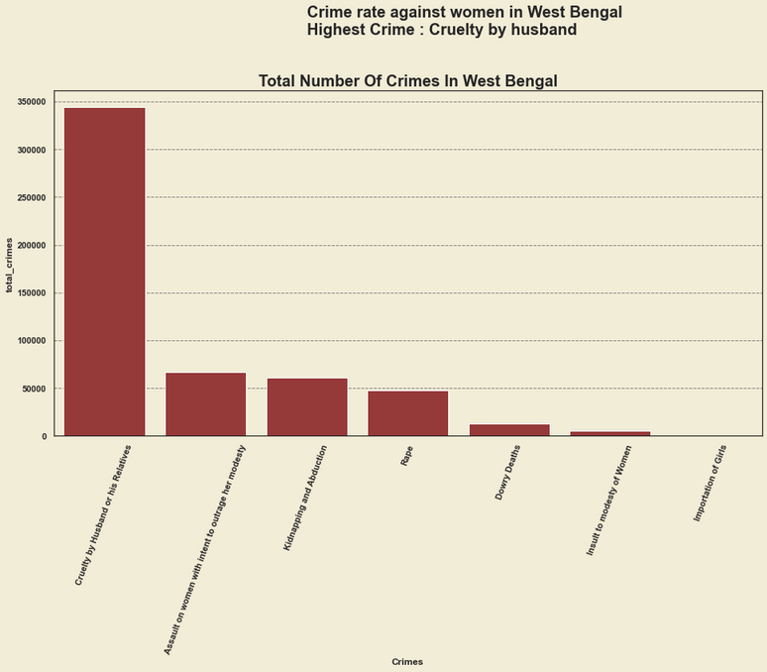
EXPLORATORY DATA ANALYSIS
ANALYSIS OF WEST BENGAL
TOTAL NUMBER OF CRIMES PER CATEGORY IN WEST BENGAL FROM 2001-2014
PIE CHART SHOWING DISTRIBUTION OF TOTAL NUMBER OF CRIMES IN WEST BENGAL PER YEAR

Slide 16
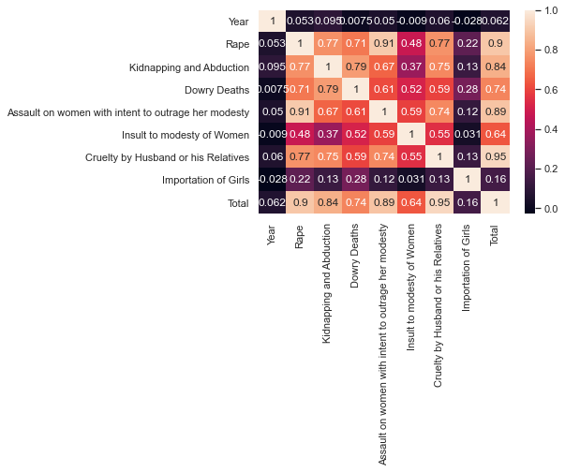
EXPLORATORY DATA ANALYSIS
CORRELATION BETWEEN FEATURES
PEARSON CORRELATION PLOT BETWEEN FEATURES

Slide 17
INSIGHTS AND DISCUSSION
From the Year-wise analysis the following insights were drawn:
The total number of crimes steadily increased from 2001 to 2014 with a value of 265,000 in 2001 to a value of 652,000 in 2014
Rape, Kidnapping and Abduction, Assault on women, Cruelty by husband or relative all peaked at year 2014
Dowry Deaths peaked at year 2011
Insult to modesty of women peaked at 2013 and importation of girls peaked at 2005

Slide 18
INSIGHTS AND DISCUSSIONS
From 2001 through to 2014, the most prevalent crimes against women was “Cruelty by Husband or Relatives"
This is followed closely by Assault on women, Rape, Insult to modesty of women, Dowry deaths and importation of girls in that order.

Slide 19
INSIGHTS AND DISCUSSION
From the State-wise analysis the following insights were drawn:
The top 5 states with the highest number of crimes from 2001 to 2014 are: Uttar Pradesh, Andhra Pradesh, West Bengal, Rajathan and Madhya Pradesh in that order. Only the top 3 states were analysed.
The 5 states with the least amount of crimes from 2001 to 2014 are: Sikkim, Nagaland, D&N Haveli and Lakshaweep in that order.
Madhya Pradesh had the highest number of Rape cases and Assault on women from 2001 to 2014. Uttar Pradesh had the highest number of kidnapping and adbuction and Dowry Deaths cases. Andrah Pradesh has the highest number of cases of Insult to modesty of Women. Finally, West Bengal has the highest number of cases of Cruelty by Husband or His Relative.

Slide 20
INSIGHTS AND DISCUSSION
The most prevalent crime in Uttar Pradesh was Cruelty by Husband or His Relative while the least is Importation of girls
The most prevalent crime in Andhra Pradesh was Cruelty by Husband or His Relative while the least is Importation of girls
The most prevalent crime in West Bengal was Cruelty by Husband or His Relative while the least is Importation of girls

Slide 21
INSIGHTS AND DISCUSSIONS
Discussions:
As mentioned earlier, Cruelty by husband and relatives is the most prevalent crime perpetrated against women in India. This is because there has been a long standing gender inequality present in the country. This reason contributes to India's Gender Inequality Index rating of 0.524 in 2014 putting it in the bottom 20% of ranked countries that year.
According to Wikipedia, 38% of Indian men admit that they have physically abused their parners. Also, every 9 minutes, a case of cruelty is committed by either husband or a relative to the husband.

Slide 22
INSIGHTS AND DISCUSSIONS
Uttar Pradesh has the largest Urban system in the country with 630 municipalities. This suggests that urbanization is one main factor that influences these crimes. In most urbanized areas there is a significantly high male to female ratio.
Andhra Pradesh and West Bengal are also Urban States which corroborates the inference drawn earlier.
There is a high correlation between Rape and kidnapping. This could suggest that women who were kidnapped or abducted were raped by their abductees.

Slide 23
RECOMMENDATION AND CONCLUSION
From research, it was seen that alcoholism, social media, and early marriages all contributed directly or indirectly to the rise in crime against women in India over the years.
There should be prohibition of alcohol use in mass gatherings in institutions, public places like trains and buses. The number of alcohol outlets should be decreased. The age for purchasing alcohol may be raised by some years. Special checks on festive occasions are recommended with the help of breath analyzers. Involuntary treatment of persons with alcohol dependence should be carried out.

Slide 24
RECOMMENDATION AND CONCLUSION
Sexual material should be censored. Good themes, which condemn violence and glorify rehabilitation of the victim, should be projected. This would go a long way in reducing the number of rape cases.
Code of conduct at work place, school and home, with respect to interaction with persons of opposite sex should be outlined and implemented.
Efficient and accountable law enforcement machinery at all levels (administration, government, police and judiciary) is needed.

Slide 25
RECOMMENDATION AND CONCLUSION
Gender sensitization by parents and teachers is needed regarding the sensitivities and boundaries of man-woman relationships.
Parents and teachers should strive to infuse good moral and religious values in children and serve as role models.
Last, but not the least, If we are sincere we will get the results. Let us all say “No” to violence against women.

Slide 26

THANK YOU!

